Slide 1




SIMULATE A PHISHING ATTACK
AND
PROPOSE EFFECTIVE COUNTER MEASURES
Presented By:
Palak Mishra
AP22110011482

Slide 2

What Is Phishing Attack?
Phishing attacks are cyberattacks where attackers trick individuals into revealing sensitive information like usernames, passwords, or credit card details. They often use fake emails or links that appear to come from trusted sources, such as banks or official websites. These attacks rely on social engineering tactics—like urgent messages or fake login pages—and can lead to identity theft, financial loss, or system breaches.

Slide 3



Objective of the Project
Simulate an email phishing attack to capture credentials.
Demonstrate how attackers can exploit trust.
Propose effective countermeasures.

Slide 4


Tools & Technologies Used
Kali Linux
Zphisher
Kali Linux is a penetration Linux distribution.
It provides powerful security tools and pre-installed software required for ethical hacking and cybersecurity assessments.
Zphisher is an advanced phishing toolkit.
It automates the process of creating fake login pages for various platforms (e.g., Facebook, Gmail, Instagram).
Serveo
Gmail
Serveo is used to expose local servers to the internet through SSH tunneling.
It helps in generating a public URL from a localhost site, allowing the phishing site hosted locally to be accessed remotely.
Gmail is used to send phishing emails containing the malicious link.
It acts as a communication channel between the attacker (researcher) and the simulated victim.

Slide 5
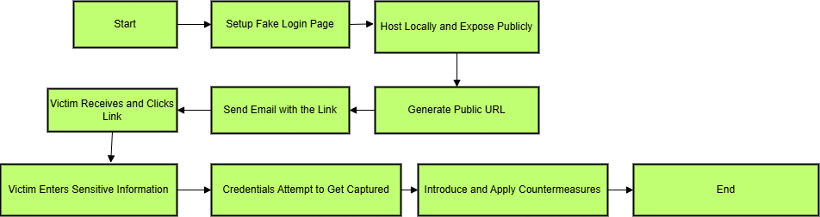
Flow Of The Project

Slide 6

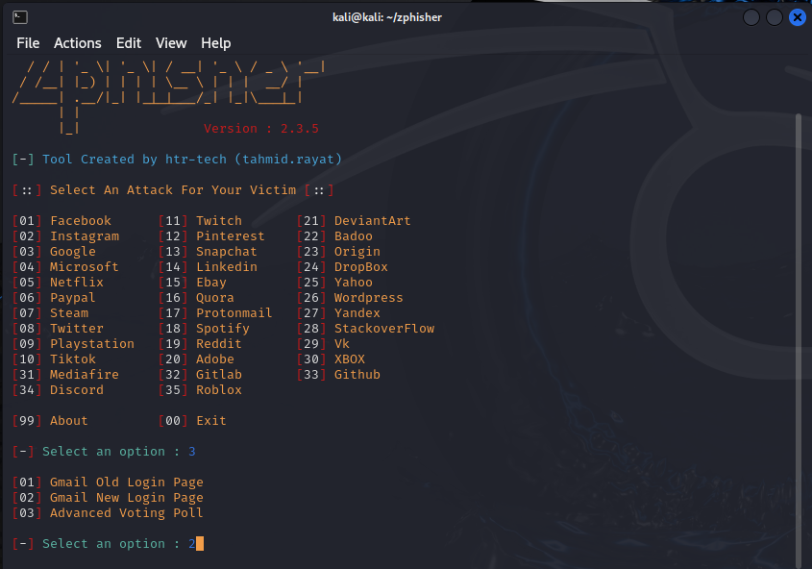
Steps
Launch Zphisher :
Use this command:
cd zphisher
bash zphisher.sh

Slide 7

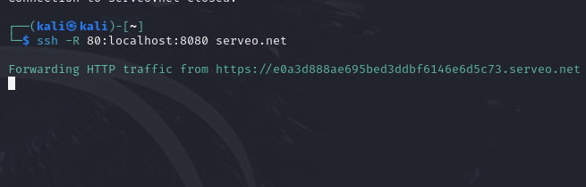
2. Use Serveo :
Use this command:
ssh -R 80:localhost:8080 serveo.net

Slide 8

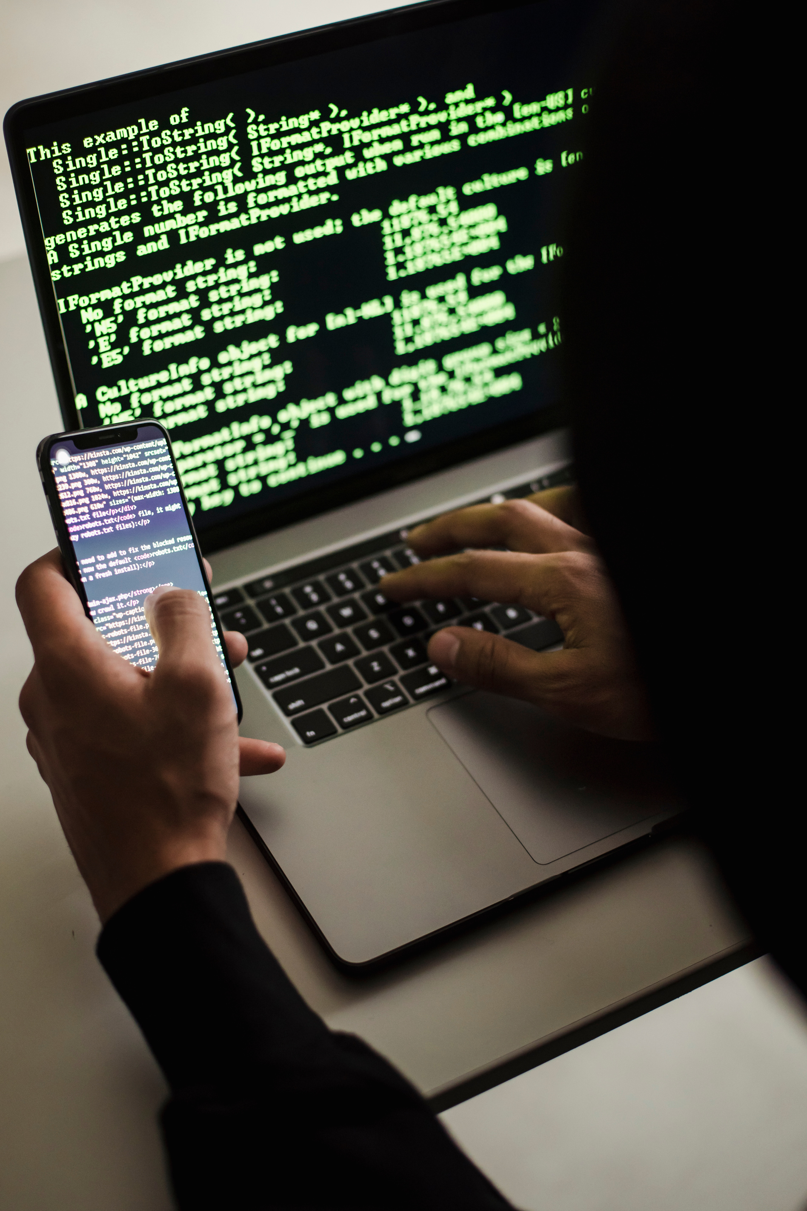

3. Send Phishing Email
Write a realistic email template (e.g., “Security alert” or “Urgent login required”).
Include the phishing link (public URL from Serveo).
Send email to yourself or another test email via Gmail.

Slide 9

Open the phishing link.
Fill in fake credentials to simulate victim behavior.
4. Click the Link as Victim

Slide 10


5. Capture the Data
Zphisher will log the entered username and password.
You can find these in the terminal or inside Zphisher’s output logs.

Slide 11


6. Effective Countermeasures
Examples:
Gmail Filters & Labels: Detect and organize suspicious emails using keywords.
Awareness: Educate users to recognize and avoid phishing attempts.
Be Wary of Emails: Don’t interact with unexpected or strange messages.
Hover Before Click: Always check the real URL before clicking any link.

Slide 12

THANK YOU

